Slide 1

Using Conjoint Analysis in Analyzing Individuals' Underlying Preferences
Roya Izadi and Priscilla Torres
Gender and the Security Sector (GSS) Lab
Cornell University
September 29, 2021

Slide 2
Code of Conduct
Code of Conduct
The Cornell Center for Social Sciences provides a welcoming environment for everyone embracing all backgrounds or identities. All instructors and attendees agree to abide by our community norms. We encourage the following behaviors in our workshops:
Respect differing viewpoints and ideas
Share your own perspectives and ask any questions
Accept constructive criticism
Use welcoming and inclusive language
Show courtesy and respect for all instructors and attendees
If you believe that an instructor or attendee has violated the code of conduct, please report the violation to CCSS-RS@cornell.edu. We take all reported incidents seriously.

Slide 3
Land Acknowledgement
Land Acknowledgment
Cornell University is located on the traditional homelands of the Gayogo̱hó꞉nǫ' (the Cayuga Nation). The Gayogo̱hó꞉nǫ' are members of the Haudenosaunee Confederacy, an alliance of six sovereign Nations with a historic and contemporary presence on this land. The Confederacy precedes the establishment of Cornell University, New York state, and the United States of America. We acknowledge the painful history of Gayogo̱hó꞉nǫ' dispossession, and honor the ongoing connection of Gayogo̱hó꞉nǫ' people, past and present, to these lands and waters.
How to pronounce:
Note: For pronunciation of the names of the original inhabitants of the Ithaca area, Gayogo̱hó꞉nǫ' is approximately Guy-yo-KO-no and Haudenosaunee is approximately Ho-di-no-SO-ni. Please also listen to Gayogo̱hó꞉nǫ' language teacher Steve Henhawk’s pronunciation in this video associated with his Gayogo̱hó꞉nǫ' language course at Cornell.

Slide 4
What is Conjoint Analysis?
Conjoint analysis is a research technique/survey methodology that can be used to identify individuals’ preferences and evaluate the trade-offs they would make in their decision-making.
Conjoint experiments are not limited to any field. Researchers across different fields and industries can utilize conjoint analysis to understand the perceived importance and preference of their subjects given different options (aka features).

Slide 5
An Industry Example (Travel Agency)
Offering the optimal travel package to customers requires an understanding of the preferences of customers in regards to price, destination, length of vacation, and other factors that influence their trade-offs and preferences.
If travel agencies can model these preferences and trade-offs, then they can offer more attractive packages thus increase the number of customers and their profits.
How can they do that?

Slide 6
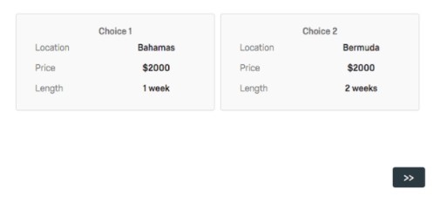
An Industry Example (Travel Agency)

Slide 7
A Social Science Example
The concept of gender protection norm:
Scholars of social science that study UN peacekeeping missions argue that personnel are more likely to send women to safer missions.
Good news: we can test this concept using Conjoint survey experiment!
How?
We randomly assign survey respondents with different scenarios that involve UN missions with different danger levels and ask respondents who they prefer to be sent to that specific mission.

Slide 8
A Social Science Example
Scenario 1: The [Country Name] Armed Forces/Police Force/Gendarmerie will deploy a UN peacekeeper to a peace operation where 195 peacekeepers have died and 25% of local women have experienced sexual violence. In the next several questions, you will be shown two pairs of soldiers/police officers/gendarmes. Please select the person that you think would be the best person to deploy to this particular UN peace operation.
Scenario 2: The [Country Name] Armed Forces/Police Force/Gendarmerie will deploy a UN peacekeeper to a peace operation where no peacekeepers have died and none of the local women have experienced sexual violence. In the next several questions, you will be shown two pairs of soldiers/police officers/gendarmes. Please select the person that you think would be the best person to deploy to this particular UN peace operation.

Slide 9
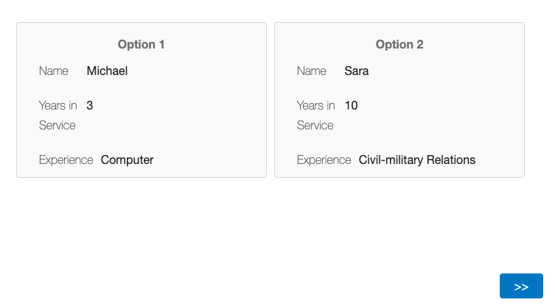
A Social Science Example

Slide 10
Understanding Feature and Levels
Features are the overall concepts you are testing.
Levels are the different choices for each feature.
Attributes are the names for each feature and all its levels, collectively.

Slide 11
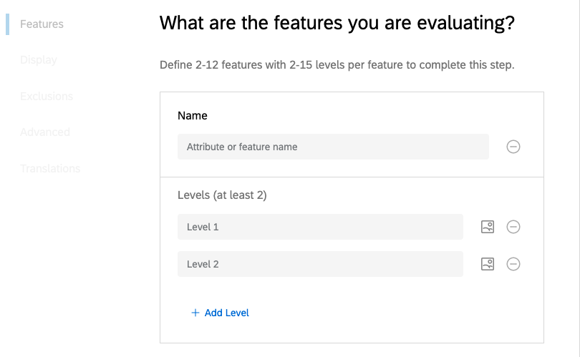
Example

Slide 12
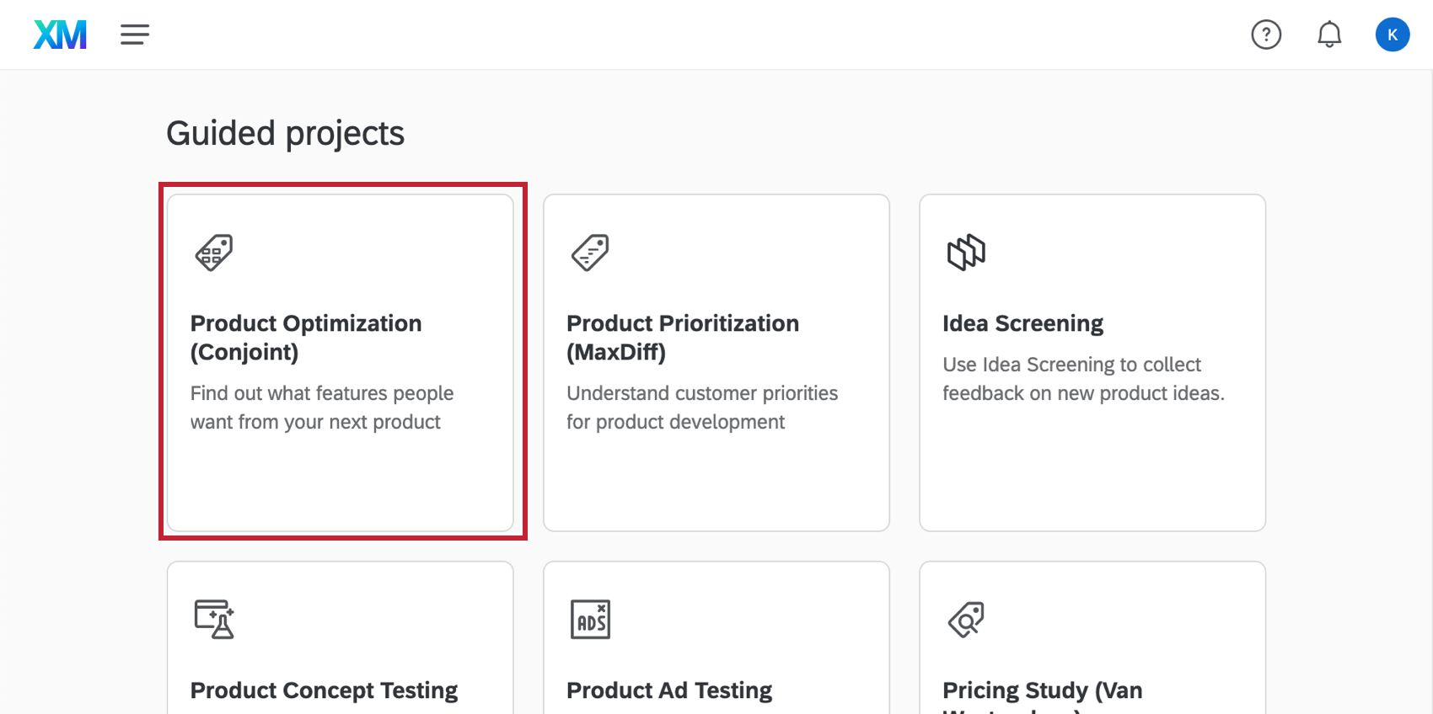
Setting up Conjoint-Overview

Slide 13
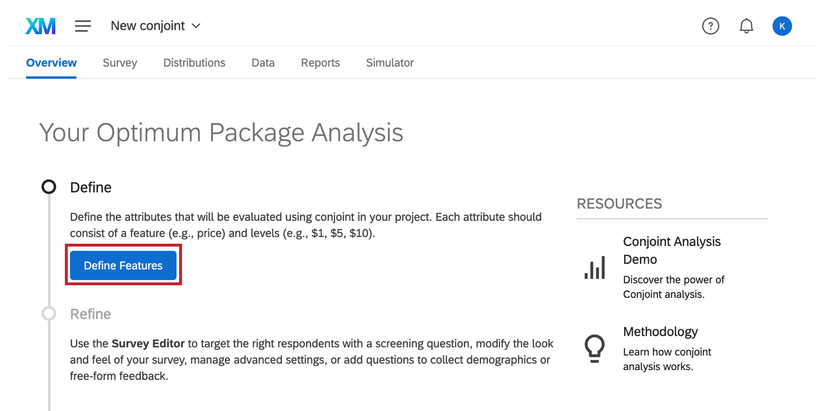
Setting up Conjoint-Overview

Slide 14
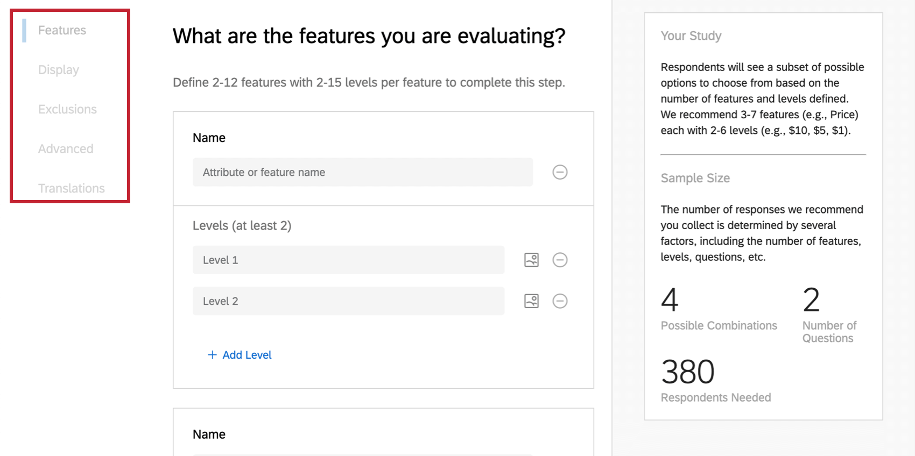
Setting up Conjoint-Overview

Slide 15
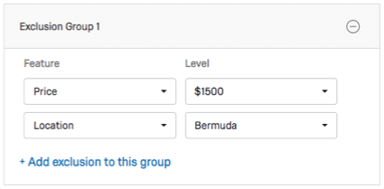
Setting up Conjoint-Overview

Slide 16
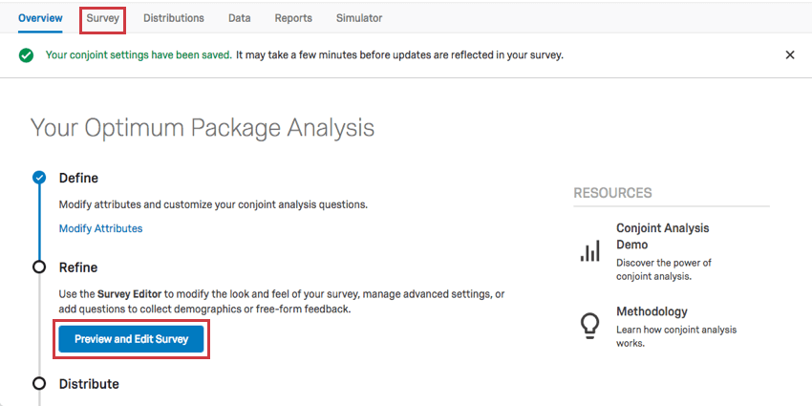
Setting up Conjoint-Overview

Slide 17
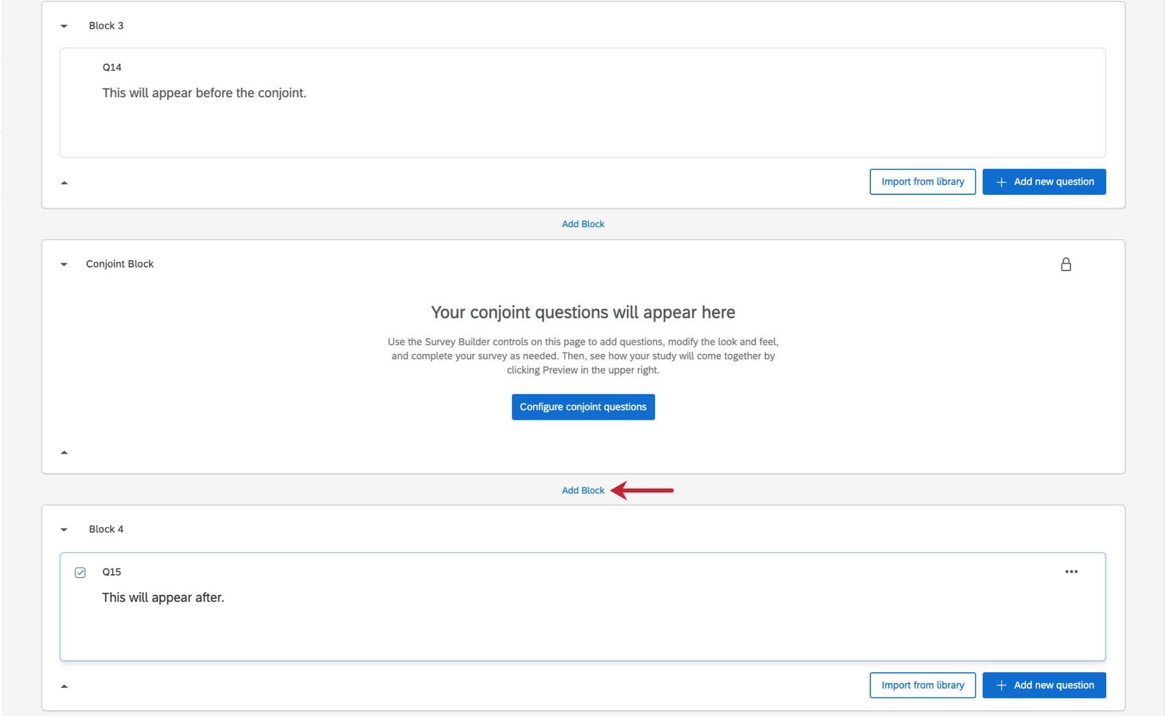
Setting up Conjoint-Overview

Slide 18
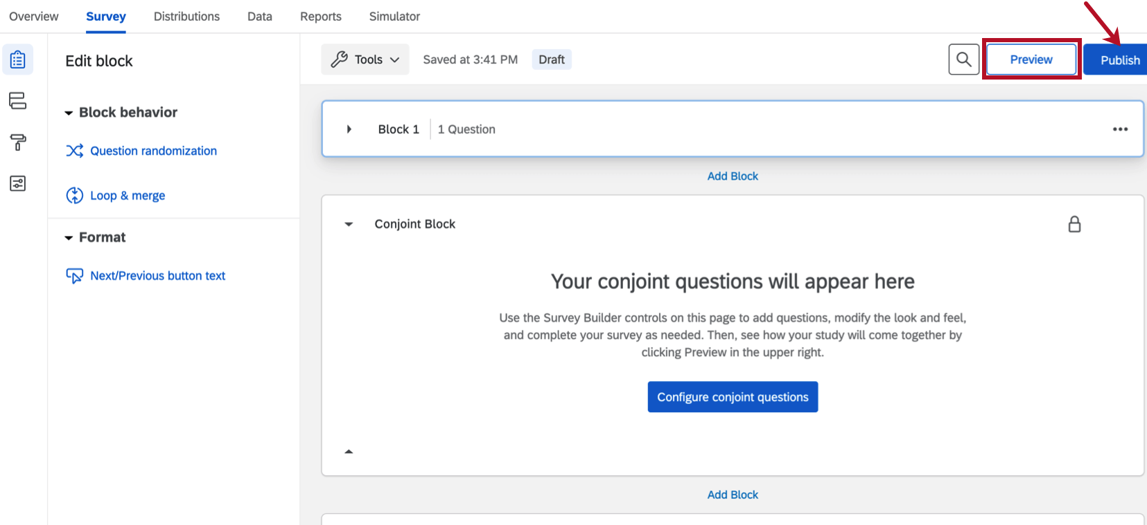
Setting up Conjoint-Overview

Slide 19
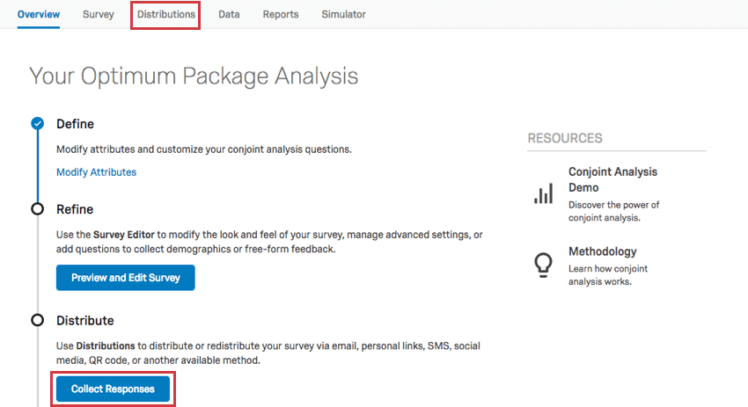
Setting up Conjoint-Overview

Slide 20
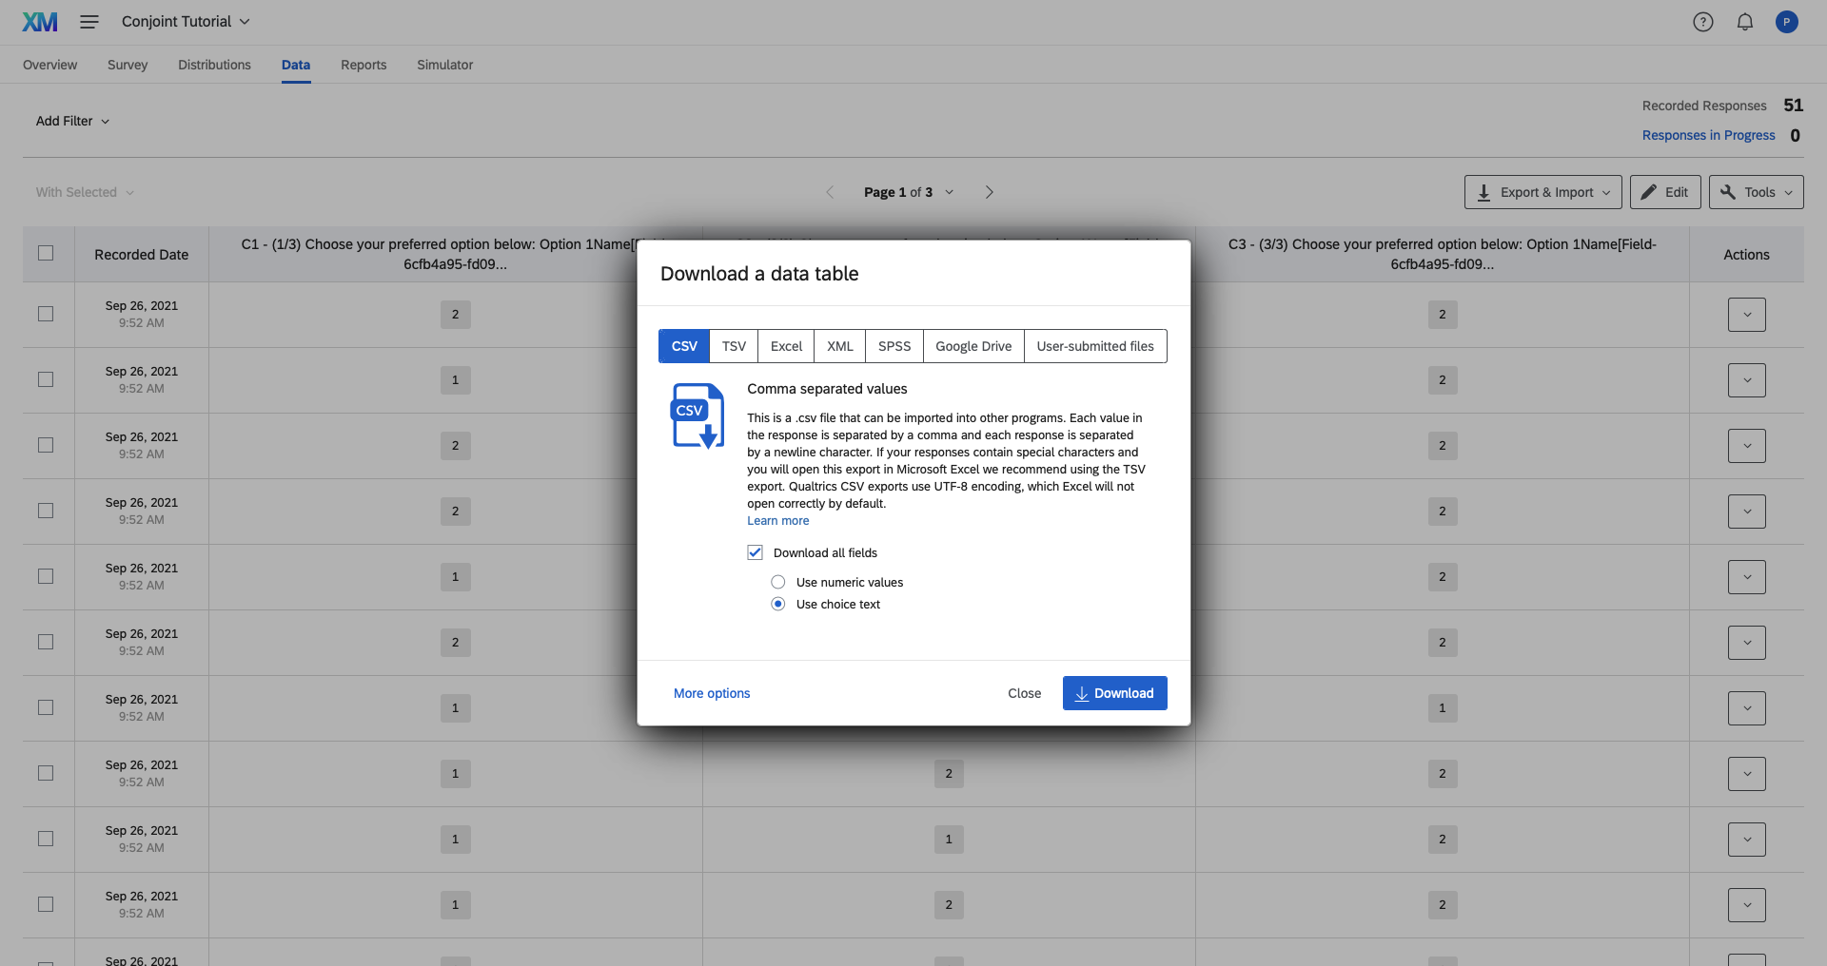
Downloading Conjoint Data From Qualtrics

Slide 21
How to Analyze Conjoint Data in R
Format the data: long-form
Current form:
Task 1 | Peacekeeper 1 | Peacekeeper 2 | Task 2 | Peacekeeper 1 | Peacekeeper 2
1 | Attributes | Attributes | 2 | Attributes | Attributes
2 | Attributes | Attributes | 2 | Attributes | Attributes

Slide 22
How to Analyze Conjoint Data Cont.
Desired Form:
Task # | Respondent # | Name | Years | Experience | Winner
1 | 5 | John | 10 | Combat | 1
2 | 5 | Sarah | 3 | Combat | 0
3 | 5 | Sarah | 3 | Computer | 0

Slide 23
How to Analyze Conjoint Data Cont.
2) Analyze the data using average marginal component effect (AMCE) or marginal means (MM)
AMCE: indicates how much the probability of choosing one candidate would change on average if one of the attributes was changed from one level to another (Hainmueller, Hopkins and Yamamoto 2014)
Requires the establishment of baseline levels within an attribute
MM: measures the favorability of a given feature (Leeper, Hobolt and Tilley 2020)
Has been argued to capture sub-group preferences more precisely than AMCE

Slide 24
R Code
In the code provided, we do both.
Note that this is just a simple introduction to conjoint analysis in R.
Please open the Rmarkdown file provided and follow along.

Slide 25
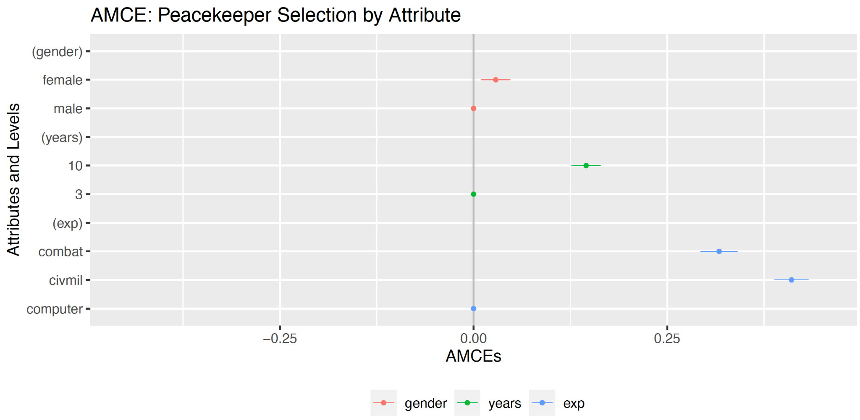
Results from GSS Lab Project (AMCE)

Slide 26
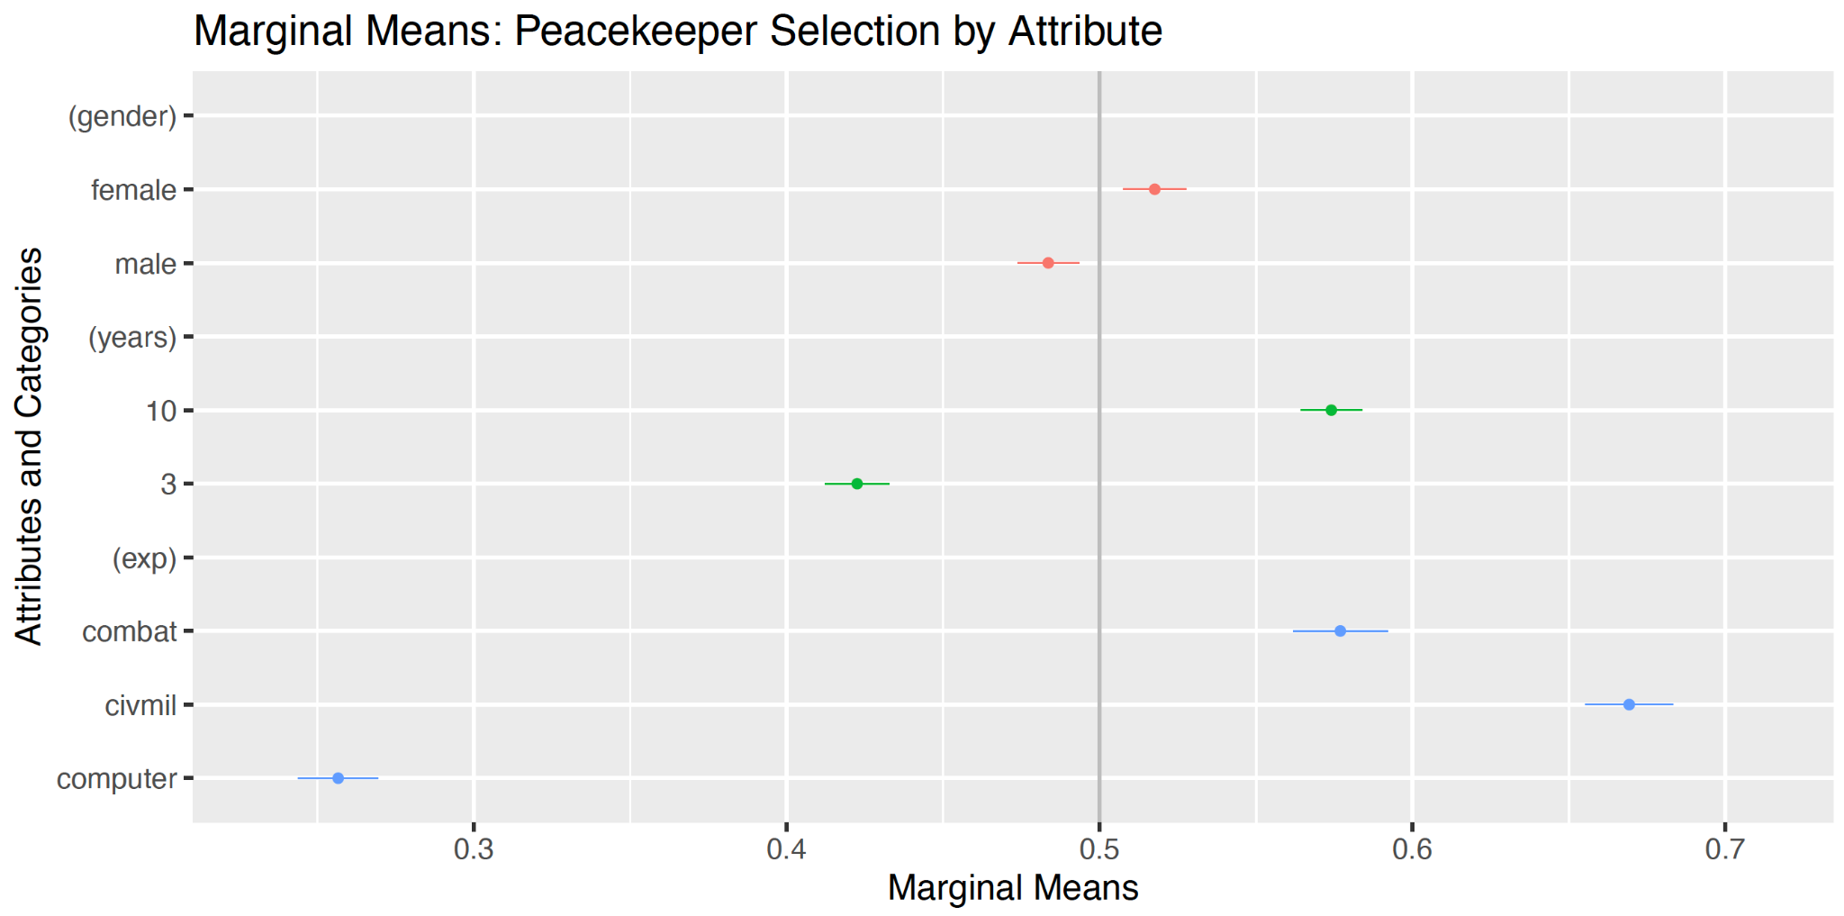
Results from GSS Lab Project (MM)

Slide 27
Thank you!

